Slide 1
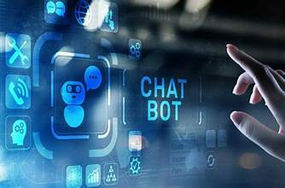
AI
CHATBOT DEVELOPMENT
Name : UMA MAHESWARI
Internship : AI intern
Batch Name : MIP-AI-01

Slide 2
Abstract
Introduction
Background
Project Objectives
Reference
Conclusion

Slide 3
Abstract
Chatbots are the next big technological evolution in the realm of conversational assistants and voice assistants in the modern technology. A chatbot, sometimes known as a bot, is a piece of code developed and built to respond effectively to users’ input, utilizing natural skills in understanding inquiries and delivering appropriate replies. Top industries and organizations are embracing new artificial intelligence-driven and deep learning-based interactive chatbots in various sectors, including banking, healthcare, finance, legal, telecommunications, retail, logistics, travel, auto, sports, entertainment, and media. we compare various chatbots based on their features, technologies, languages, and application areas. Chatbots based on AI and deep learning are now becoming an indispensable part of interaction with machines for assistance and resolving customers’ queries.

Slide 4
Introduction
Conversational chatbots, also known as chatbots or dialogue systems, are software programs designed to simulate conversation with human users, especially over the Internet. These chatbots can be used in various contexts, such as customer service, information acquisition, educational support, and entertainment. Conversational chatbots have become an increasingly popular tool in recent years. These computer programs are designed to simulate conversations with human users by utilizing Natural Language Processing (NLP) techniques like ChatGPT and applying them to a variety of applications, including casual entertainment purposes, customer services and educational purposes to assist teachers and students.
Ranging from casual and open domain to more domain-specific and fact-based, these chatbots are built using various deep learning models, such as RNN (Recurrent Neural Network), Seq2Seq (Sequence to Sequence), LSTM (Long Short-Term Memory), BERT (Bi-directional Encoder Representation from Transformers), GPT (Generative Pre-trained Transformer)), as well as leveraging different training techniques, such as reinforcement learning or transfer learning, in order to improve the performance of NLP algorithms and chatbots. A recent popular, encouraging example is the success of ChatGPT, which received a great amount of attention and inspired researchers to generate more ideas regarding chatbot applications.

Slide 5
Background
In today's dynamic digital landscape, the integration of AI-powered chatbots has become imperative for businesses to enhance user engagement, provide efficient customer support, and streamline communication processes. Your task is to create a conversational chatbot leveraging either Langchain or OpenAI, two prominent platforms known for their natural language processing capabilities.

Slide 6
Project Objectives
What is AI chatbot?
Chatbot comes under three category
Why we need Chatbot?
Diagram of Chatbot Conversation Framework
Diagram of Architecture of AI Chatbot (Voicebase)
Evaluating the models & making Predictions.

Slide 7
What is a CHATBOT?
A chat robot, a computer program that simulates human conversation, or chat, through artificial intelligence. It is a service, powered by rules and artificial intelligence, that you interact with via a chat interface.
The service could be any number of things, ranging from functional to fun, and it could live in any major chat product (Facebook Messenger, Slack, Telegram, Text Messages, etc).

Slide 8
Chatbot Comes under three category
Rule-based chatbots: These bots respond to users' inputs based on certain pre-specified rules. For instance, these rules can be defined as if-elif-else statements. While writing rules for these chatbots, it is important to expect all possible user inputs, else the bot may fail to answer properly. Hence, rule-based chatbots do not possess any cognitive skills.
Retrieval-Based: These bots respond to users inputs by retrieving the most relevant information from the given text document. The most relevant information can be determined by Natural Language Processing with a scoring system such as cosine similarity score. Though these bots use NLP to do conversations, they lack cognitive skills to match a real human chatting companion.
Intelligent AI chatbots: These bots respond to users' inputs after understanding the inputs, as humans do. These bots are trained with a Machine Learning Model on a large training dataset of human conversations. These bots are cognitive to match a human in conversing. Amazon's Alexa, Apple's Siri fall under this category. Further, most of these bots can make conversations based on the preceding chat texts.

Slide 9
Why we need Chatbot?
Apps Consume most of the memory of the device.
Hence the user’s do not want to use separate apps for separate purposes.
Trends shows that over 90% of all the apps are uninstalled after its fast use.
Developing a chatbot takes significantly less time and it is also easy to maintain and less expensive as compared to apps.

Slide 10
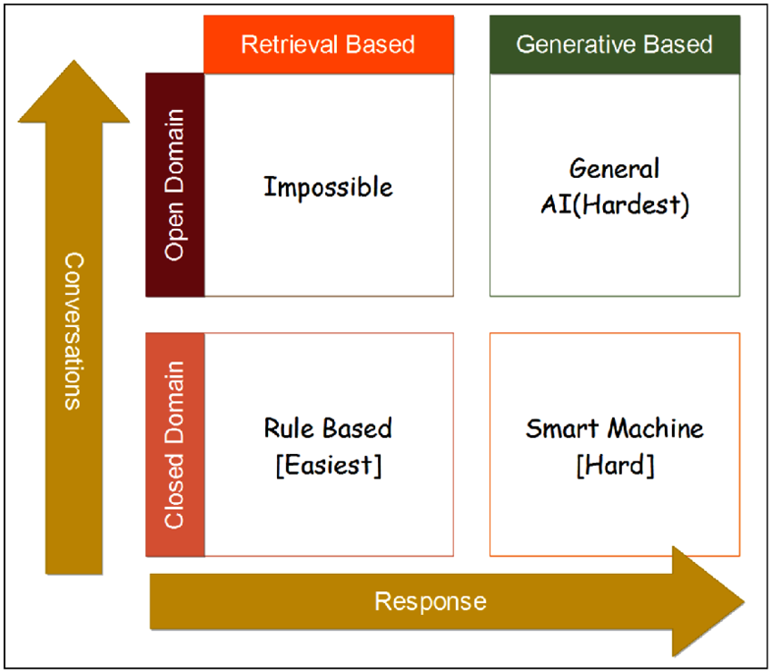

Slide 11
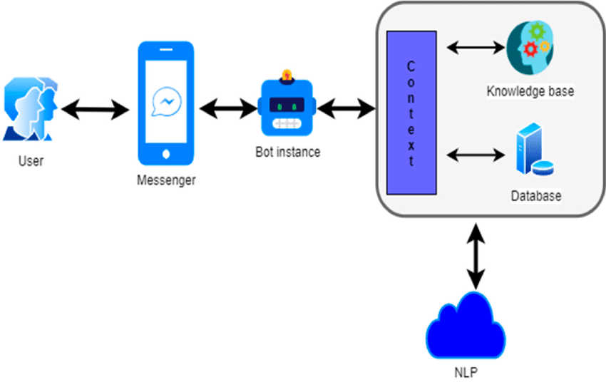
Diagram of Chatbot Conversation Framework

Slide 12
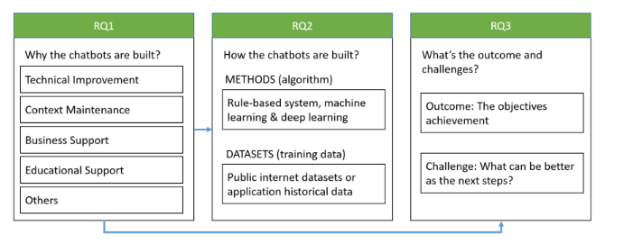
Considerations of surveyed for RQ

Slide 13
Evaluating the model & making Predictions
After training the model we can evaluate it on the test set.
This will run the evaluation metrics on the test set instead of the validation set.
We will get probability scores for unseen data.
We could imagine feeding in 100 potential responses to a context and then picking the one with the highest score.

Slide 14
Conclusion
The evolution of conversational chatbots from 3 perspectives: construction objectives (RQ1), applied algorithms (RQ2), and outcomes and challenges (RQ3), and the discussion process is shown in (Figure of Considerations of surveyed for RQ) From the perspective of the development objectives of conversational chatbots, the main objective was not only to improve technical aspects by providing accurate responses, but to ensure that users needs are met through context maintenance. We also discussed some research related to business and educational support, which leverage chatbots by either supporting potential business revenue increases, playing the role of a learning companion, or assisting in the enhancement of teaching skills.
NLP (Natural Language Processing) technologies are being applied to architecture when building conversational chatbots.This may be because, by nature, we want chatbots to imitate human conversational capability, especially when designing an open-domain chatbot that does not have a pre-defined when the fundamental goal is providing accurate information to the users through closed domain chatbots, researchers are more interested in a dialogue system, which can express emotions and empathy.

Slide 15
Reference
Kanodia, N.; Ahmed, K.; Miao, Y. Question Answering Model Based Conversational Chatbot using BERT Model and Google, (Dialog Flow) In Proceedings of the 2021 31st International Telecommunication Networks and Applications Conference (ITNAC), Sydney, Australia, 24–26 November 2021; pp. 19–22.
Zhou, L.; Gao, J.; Li, D.; Shum, H.Y. The design and implementation of xiaoice, an empathetic social chatbot. Comput. Linguist(2020, 46, 53–93).
Jianfeng, G.; Michel, G.; Lihong, L. Neural approaches to conversational AI. Found. Trends Inf. Retr. 2019, 13, 127–298.
Lee, D.; Yeo, S. Developing an AI-based chatbot for practicing responsive teaching in mathematics. Comput. Educ. 2022.

Slide 16


